Slide 1
Natural Hazards and Agriculture
In October 2010, the UN Food and Agriculture Organization (FAO) estimated that 13.6% of the world population (nearly 1 billion people, or 1 in every 7 people) was malnourished, increasing by 10 million a year, and about six million children died each year from a hunger-related illness before their fifth birthday.

Slide 2
Natural Hazards and Agriculture
Global grain production increased by 150% between 1961 and 2009, a period in which the area under cultivation expanded by only 12%. The dynamic performance of food production in Asia over the last half of the 20th Century has been described as the “green revolution”.
However, a major flaw in sustainability of the “Green Revolution” was the emphasis on monoculture practices. The new focus must instead embrace ecologically sound practices, biodiversity, and the vast experience of indigenous knowledge to cope with climate extremes and their impacts on food and water security.

Slide 3
Natural Hazards and Agriculture
How do we significantly increase agricultural production without further stressing our environment; or destroying our natural forests and further threatening endangered species; and, without further diminishing our water resources to feed a world population, which is expected to increase from under 7 billion to about 9 billion by 2050?
FAO concluded that global food production must rise by 70% by 2050 to meet the demands of world population growth of more than 30%. About 80% of this increased production must come from existing arable land through higher yields.

Slide 4
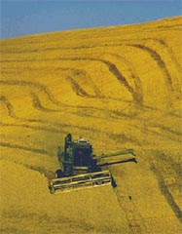
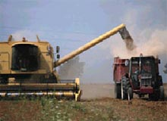

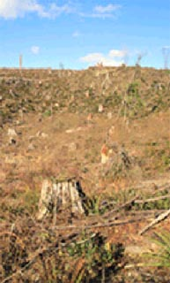
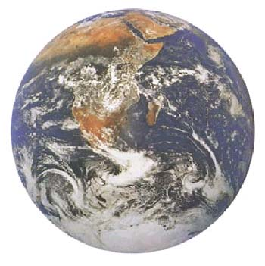
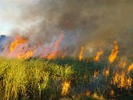
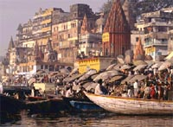
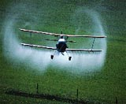
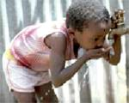
The Challenge: Sustainable Agriculture in a Changing Climate

Slide 5
Natural Hazards and Agriculture
Today’s agriculture sector faces a complex challenges:
produce more food while using less water per unit of output;
contribute in a productive way to the local and national economy by understanding local indigenous customs;
protect the health of the ecosystem and ensure environmental sustainability through “eco-farming”, such as developing cultivation skills in soil regeneration, nitrogen fixation, natural pest control and agro-forestry.
reduce food shortages, famine, and hunger while coping with changing climate and the increasing frequency of natural hazards that threaten our water supplies and agricultural resources.

Slide 6
Natural Hazards and Agriculture
Food security is achieved when all people, at all times, have physical, social and economic access to sufficient, safe and nutritious food to meet their dietary needs and food preferences for an active and healthy life (FAO).
Food riots in 23 developing countries prompted a global crisis when the FAO Cereal Price Index doubled in the year to April 2008. Another round of increases, of similar extent, was triggered in mid-2010 in the aftermath of poor harvests and export bans in Russia and Ukraine.

Slide 7
Natural Hazards and Agriculture
It is estimated that over 60% of worldwide water use is for irrigation. Estimates are that it takes around 3,000 litres of water to produce enough food to satisfy one person's daily dietary need. Only two and five litres of water are required for drinking!
To produce food for the nearly 7 billion people who inhabit the planet today requires the amount of water that would fill a canal ten metres deep, 100 metres wide and 7.1 million kilometres long, or the distance to circle the globe 180 times.

Slide 8
Natural Hazards and Agriculture
Today, the competition for water resources is intense. There are now nearly seven billion people whose consumption of water-thirsty meat and vegetables is rising, while there is increasing competition for water from industry, urbanisation and biofuel crops. More than 1.2 billion, live in areas of physical water scarcity, where there is not enough water to meet all demands.

Slide 9
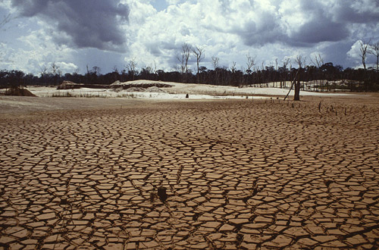
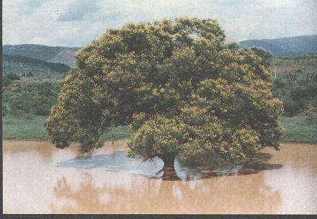
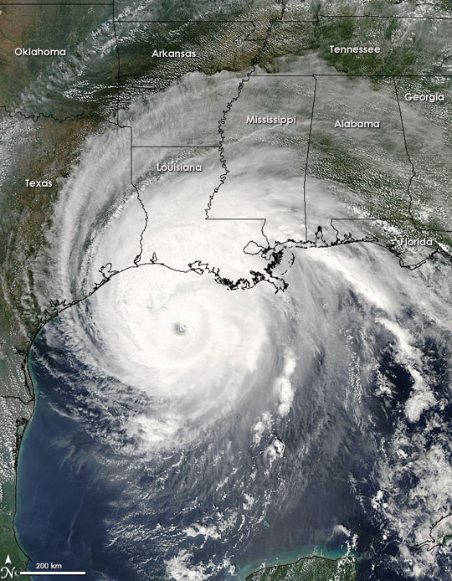
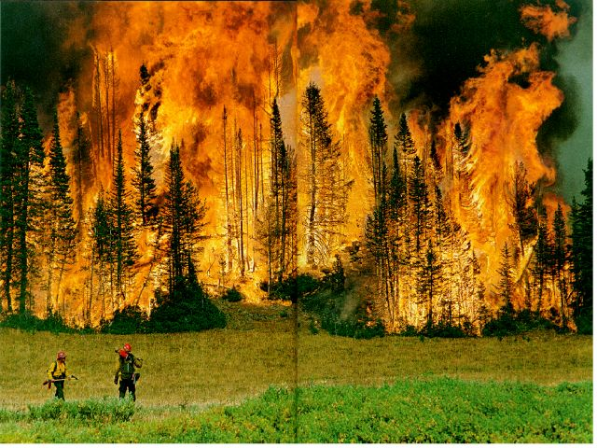
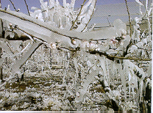
Major Natural Disasters
September 2005 – Hurricane Rita

Slide 10
Natural Hazards and Agriculture
Drought – Around 220 million people were found to be exposed annually to drought.
Flood – About 196 million people in more than 90 countries were found to be exposed on average every year to catastrophic flooding.
Tropical Cyclone – Up to 119 million people were found to be exposed on average every year to tropical cyclone hazard and some people experienced an average of more than four events every year.

Slide 11
Climate Extremes and Agriculture
Climate variability and extremes have increased in frequency, amplitude and duration over the past 30 years.
Agriculture around the world has been impacted significantly by climate in terms of crop losses, economic losses, famine, and social unrest.
Severe droughts, floods, heat waves, freezes & tropical storms have caused extensive damage to crops in critical growth stages of development.
However, the impact of some events (i.e., droughts & floods) can last several years

Slide 12
Risk Management Strategy for
Decision Making
  Based on preparedness (early-warning), mitigation (preventive measures) and adaptation (coping strategies).
  Incorporates weather and climate knowledge into planning and management decisions for agricultural production.
  Achieve a sustainable, optimized production level through the use of weather and climate information, while maintaining environmental integrity and minimizing the degradation of soil, nutrient and water resource bases.
  Technology (fertilizers, new seed varieties, farming practices) should aid production but not harm the resource base in the long term.

Slide 13
Weather, Water and Climate Information
Assessments: Monitoring for sector analysis and impact studies.
Analogues: Historical analyses of archived data for comparative studies (similar years on record).
Forecasts: Early-alert of impending episodic events affecting agriculture, such as flooding, drought, severe storms, heat wave, freeze etc.
Outlooks: Guidance for long-term scenario analyses, including impact of climate extremes, variability and change.
Decision-Making Process: Right information to the right user at the right time in the right format for informed decision making!

Slide 14
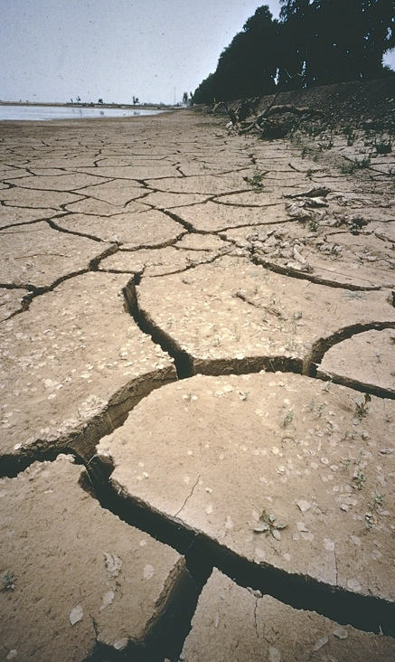
Droughts are among the most complex natural hazards
Drought is a creeping phenomenon with slow onset
It is difficult to define when it begins and when it ends
That makes prediction and hence early warning so difficult
The definition and the impact of droughts is highly depending on regional or even local geographic and meteorological conditions

Slide 15
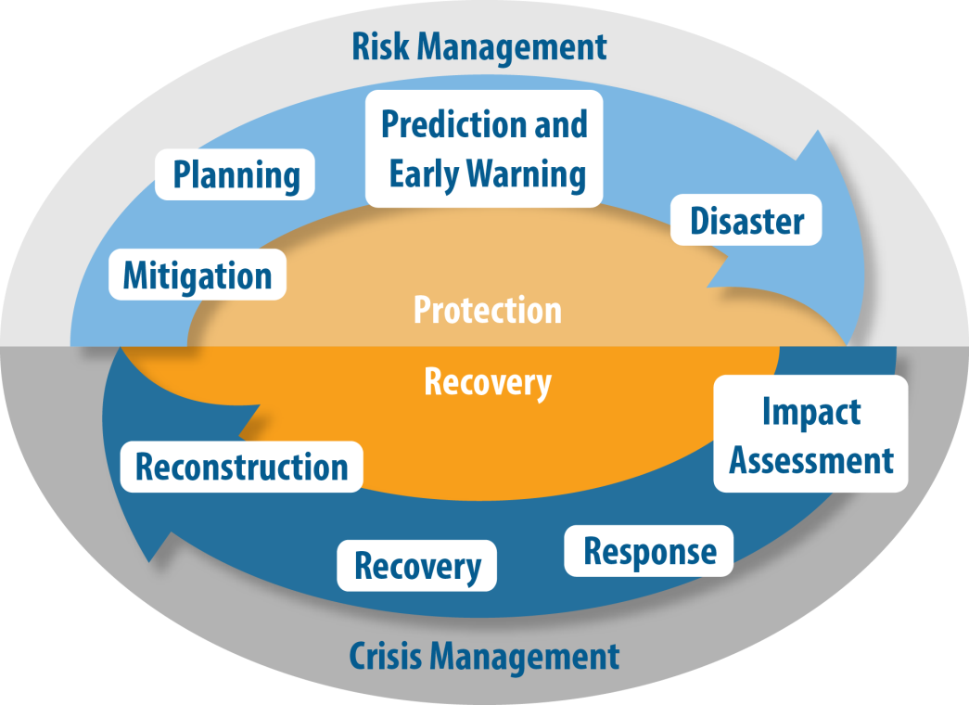
Towards a paradigm shift
From crisis to risk management
Proactive
Reactive
Source: Adapted from National Drought Mitigation Center, http://drought.unl.edu
A need to develop risk-based drought management policies
Notes:
10-step recommendation
Appoint a national task force on drought
Define the goals of a national risk-based drought policy
Hold consultations with everyone, from communities to top policymakers, and resolve water-based conflicts between sectors
Get data on the available and required resources to prevent and respond to drought and on which communities are most vulnerable
Prepare the key elements of a drought policy: monitoring, early warning, prediction; risk and impact assessments; and mitigation and response measures
Identify the research needs and gaps within institutions that deal with drought-related issues
Integrate the science and policy aspects of drought management
Publicize the policy and build awareness
Develop educational programmes for all age groups and communities
Evaluate and revise the policy
15

Slide 16
CAgM Activities on Natural Hazards
2000-2013 (See Table 1)
Five Expert Meetings:
-- Early Warning System for Drought Preparedness
-- Impacts of Natural Disasters and Mitigation of Extreme Events
in Agriculture
-- Management of Natural and Environmental Resources in
Sustainable Agricultural Development
-- Two meetings of Working Groups on Agricultural and
Hydrological Drought Indices

Slide 17
CAgM Activities on Natural Hazards
2000-2013
Four International Workshops:
-- Coping with Agrometeorological Risks and Uncertainties –
Challenges and Opportunities
-- Drought and Extreme Temperatures: Preparedness and
Management for Sustainable Agriculture
-- Integrated Drought Information Systems
-- International Workshop on Advances in Operational Weather
Systems for Fire Danger Rating
One Inter-Regional Workshop on Indices and Early Warning Systems for Drought
ANADIA(Assessment of Natural Disaster Impacts on Agriculture) Task Force Project Meeting and Project

Slide 18
CAgM Activities on Natural Hazards
2000-2013
National Drought Policy Initiative: High-level Meeting. March 2013
Integrated Drought Management Programme
Joint Expert Group on Climate, Food and Water (JEG-CFW) to increase synergy in WMO activities related to food and water under a variable and changing climate
Joint JCOMM/CAgM Proposal on Marine Influences and Impacts on Lowland Agriculture and Coastal Resources (MILAC)
Expert Meeting on Potential Information Technologies and Tools for Future WAMIS Applications for Information Technology and Communication
International Symposium on Synergistic Approaches to Food and Water Security to promote Capacity Development
Several Training Events related to drought management

Slide 19
Need for a High Level Meeting on National Drought Policy (HMNDP)
Despite the repeated occurrences of droughts throughout human history and the large impacts on different socio-economic sectors, no concerted efforts have ever been made to initiate a dialogue on the formulation and adoption of national drought policies.
Among countries in the world, only Australia has a national drought policy which provides a clear description of when and how communities affected by droughts could seek drought relief under a legal framework.
World’s costliest natural disaster, incurring annually US $6-8 billion losses.

Slide 20
HMNDP Main Organizers and Partners
World Meteorological Organization (WMO)
United Nations Convention to Combat Desertification (UNCCD)
United Nations Food and Agriculture Organization (FAO)
United Nations Educational, Scientific and Cultural Organization (UNESCO)
United Nations Development Programme (UNDP)
UN-Water Decade Programme on Capacity Development (UNW-DPC)
United Nations International Strategy for Disaster Reduction (UNISDR)
World Food Programme (WFP)
Global Water Partnership (GWP)
International Fund for Agricultural Development (IFAD)
A total of 17 Organizations

Slide 21
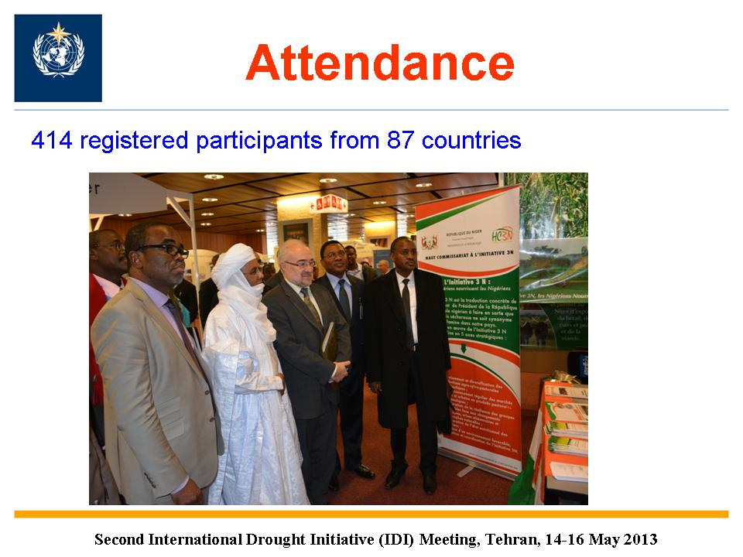

Slide 22
Launch of initiatives
2013 World Day to Combat Desertification, UN Decade for Deserts and the Fight against Desertification, and UN Decade on Biodiversity
Integrated Drought Management Programme (IDMP) with WMO & GWP
National Drought Management Policies Initiatives (NDMP) with UNW-DCP, FAO, UNCCD, & WMO

Slide 23
Integrated Drought Management Programme
WMO and the Global Water Partnership have established the Integrated Drought Management Programme. Similar to APFM
Targeting intergovernmental, governmental and non-governmental organizations involved in drought monitoring, prediction, drought risk reduction and management.
Primary beneficiaries are expected to be governmental institutions, agencies responsible for developing drought management policies and/or implementing systems for drought monitoring, prediction, preparedness and mitigation.
The principal approach to develop global co-ordination of efforts to strengthen drought monitoring, risk identification, drought prediction and early warning services and development of drought management knowledge base.

Slide 24
Current Actions - IDMP
Consultation Meeting on IDMP was held in Nov 2010. Draft Concept Note has been developed. IDMP has been approved by WMO Commission for Hydrology in Nov 2012.
WMO/GWP Preparatory Meeting – 6-7June 2013
Ad-Hoc Management Committee will be in October 2013.
IDMP will integrate and incorporate WMO efforts on drought indices and High-Level Meeting on National Drought Polices (HMNDP)
All WMO drought initiatives are linked to GFCS
IDMP webpage: www.wmo.int/idmp

Slide 25
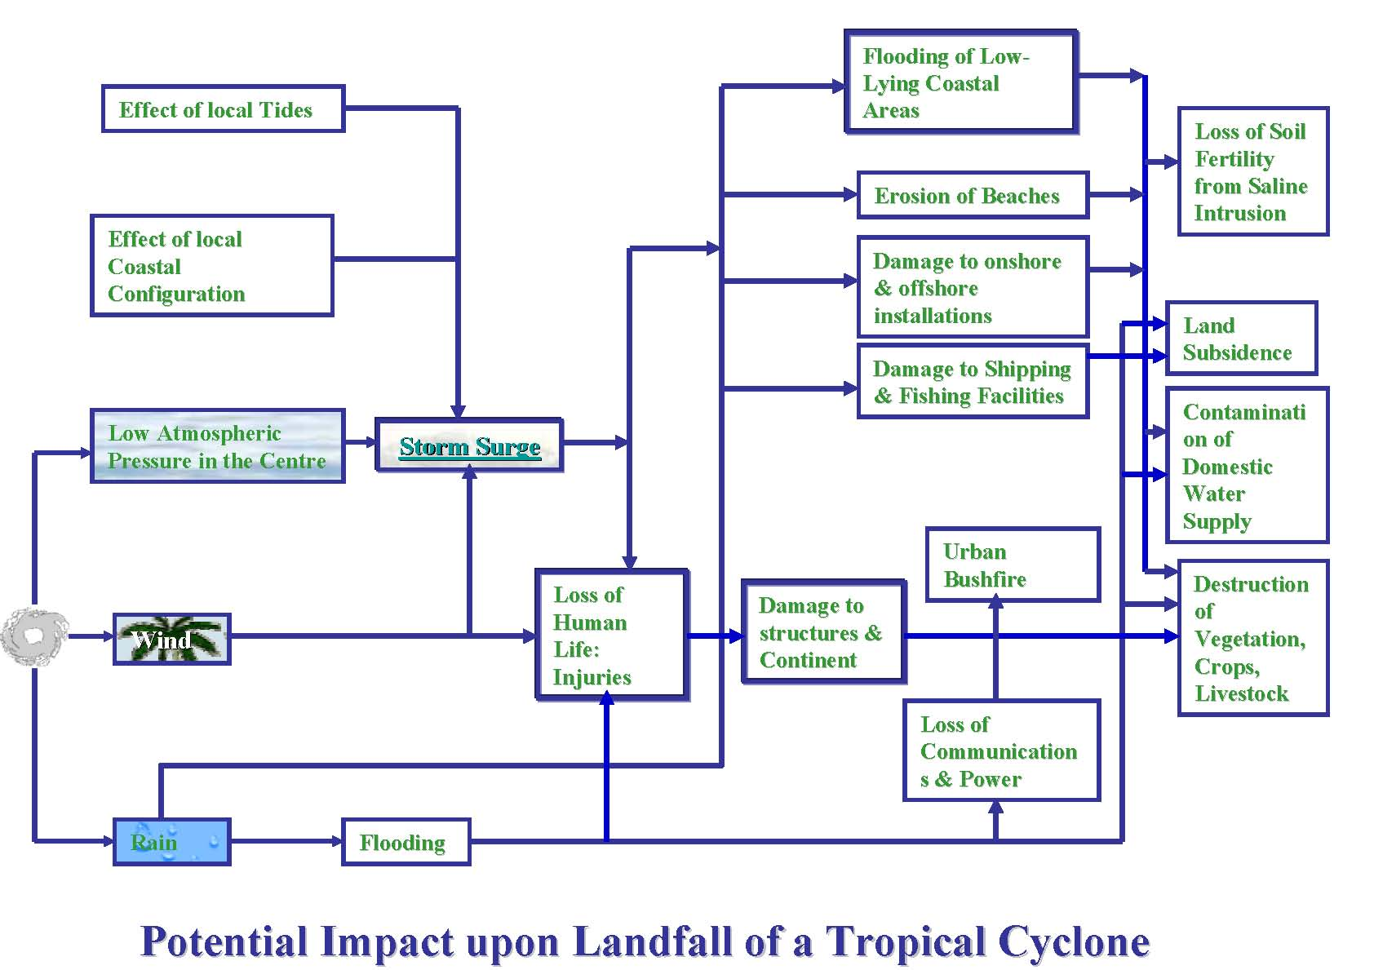
Marine Influences and Impacts of Lowland Agriculture
And Coastal Resources (MILAC)

Slide 26
Climate Extremes
Natural
Hazard
Natural
Disasters
Sectoral
Impacts
Agriculture: Crops, Livestock, Forests:
Loss of productivity
Food security
Heat Wave
Drought
Water: Irrigation, Urban, Industrial
Competition, Quality, Efficiency
Dryness
Ecosystems,
Environment
Destruction of Biodiversity
Heavy Rain
Loss of life and
Property
Quality of Life
Flood
Coastal
Ecosystem
Saline intrusion,
Beach erosion,
Water contamination,
Power disruption
Hurricanes
Storm
Surge
Wind
Cold Wave
Freeze
Damage to Crops

Slide 27
Agroclimatic System
Communication of Information--Needs
Information for farmers/local decision makers:
-- Relevant, timely and user-friendly
Advisories on farm management:
-- Planting/harvesting dates , disease spraying,
irrigation scheduling etc.
Early warning alerts of extreme weather events
Improved short-term to long-range outlook for agriculture
Media reporting (telephone, newspaper, radio, TV, mail, Internet) of forecasts, early-alert warnings and advisories

Slide 28
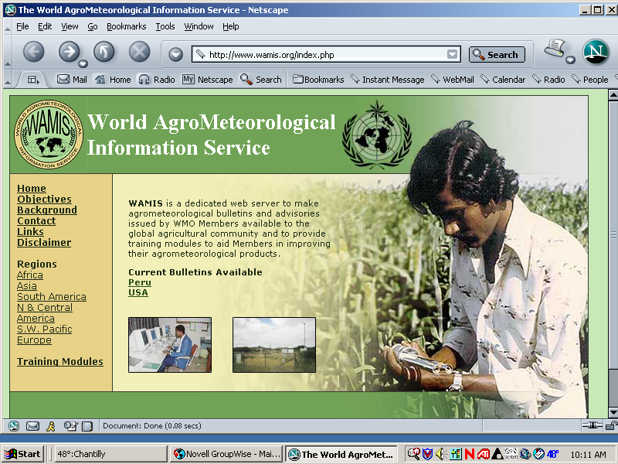
http://www.wamis.org/
Web server operational since 2003

Slide 29
World AgroMeteorological Information Service (WAMIS)
WAMIS has been operational since 2003.
Currently, 56 countries and organizations from all regions of the world use WAMIS as the host server for advisories, bulletins, tools, and resources .
These products and resources are archived on the WAMIS server for retrieval by the global user community.
Original WAMIS web server managed by WMO Agricultural Meteorology Division
http://www.wamis.org/

Slide 30

Agro-Met Decision Support System
World AgroMeteorological Information System (WAMIS)
GMU
SNU/NCAM
IBIMET
USQ
ARC
UC
Six WAMIS servers: 1) George Mason University (GMU), Fairfax, VA, USA; 2) Seoul National University (SNU)/National Center for Agricultural Meteorology (NCAM), Seoul, Korea; 3) the Institute for BioMeteorology (IBIMET), Bologna, Italy; 4) University of Southern Queensland (USQ), Australia; 5) University of Campinas (UC), Brazil; and, 6) Agricultural Research Council (ARC), Pretoria, South Africa. These WAMIS servers are interlinked to develop a “seamless decision support system for DBM, models and resources, and, DSS tools”.

Slide 31


Decision Support System for Agricultural Weather Management
Decision-Making
Risk Management:
preparedness & mitigation measures
Decision Support System
Policy Making
Farm management tools and educational aids to provide a pathway of learning for farmers
Extension
& Training
Farm
Decisions
(WAMIS)
Drought continues. Rainy season begins. Favorable planting/
cultivating…
too windy

Slide 32


Global Information Network for Agriculture and Water Security (GINAWS)
WMO
George Mason
University (GMU)
University of Florence &
Institute of Biometeorology,
Italy
Seoul National University ,
Interdisciplinary Program in
Agricultural & Forest
Meteorology, South Korea
WAMIS
Research Education
Eco-physiology
Climate Adaptation
Agrometeorological
Modeling
Research Education
Computer Technology
Sustainable Agriculture & Forest Ecosystems
Research Education
  Science
  Technology
  Policy
University of Brasilia &
Institute of Agronomy,
Sao Paulo, Brazil
University of Free State &
Institute of Soil, Water &
Climate, ARC, South Africa
University of Southern Queensland, Australian Centre for Sustainable Catchments
Research Education
Forecast Systems for
Decision Makers
Environmental Management
for Renewable Energy
Research Education
Early Warning Service
& Communication
Decision Support Systems
for local communities
Research Education
Sustainable Land & Water Management
Agroclimate Out-Reach
Climate Change Impacts

Slide 33

Global Centers of Excellence in Education and Research
Global - CEER
World Meteorological Organization
(WMO)
Southeast Climate Consortium (SECC), University of Florida, AgroClimate
Korea – CEER
Interdisciplinary Agriculture & Forest
Meteorology
Italy – CEER
Ecophysiology,
Climate Adaptation
USA – CEER
GMU
Science
Technology
Policy
WAMIS
  India – CEER
  Agricultural Advisory Services to Farmers
China – CEER
Regional Training Center
Brazil – CEER
Forecast System for Decision Makers
Australia – CEER
Land & Water
Management
Southern Africa – CEER
Early Warning Service & Communication

Slide 34
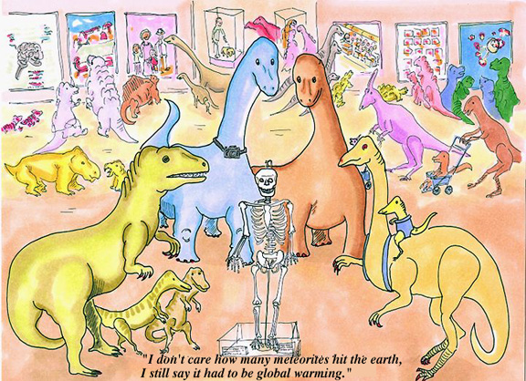
Source: http://www.english.uiuc.edu/baron/cartoons/global.htm

Slide 35
Thank You

